Slide 1
Building Value
How Authenticity Drives Member Renewals

Slide 2
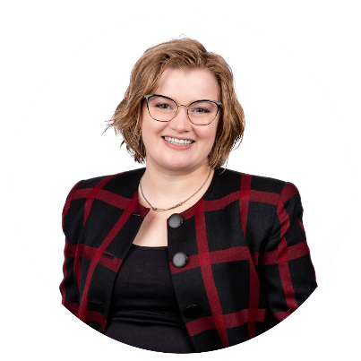
Megan Petersen
Manager of Communications
Association of Residential Resources in Minnesota (ARRM)

Slide 3
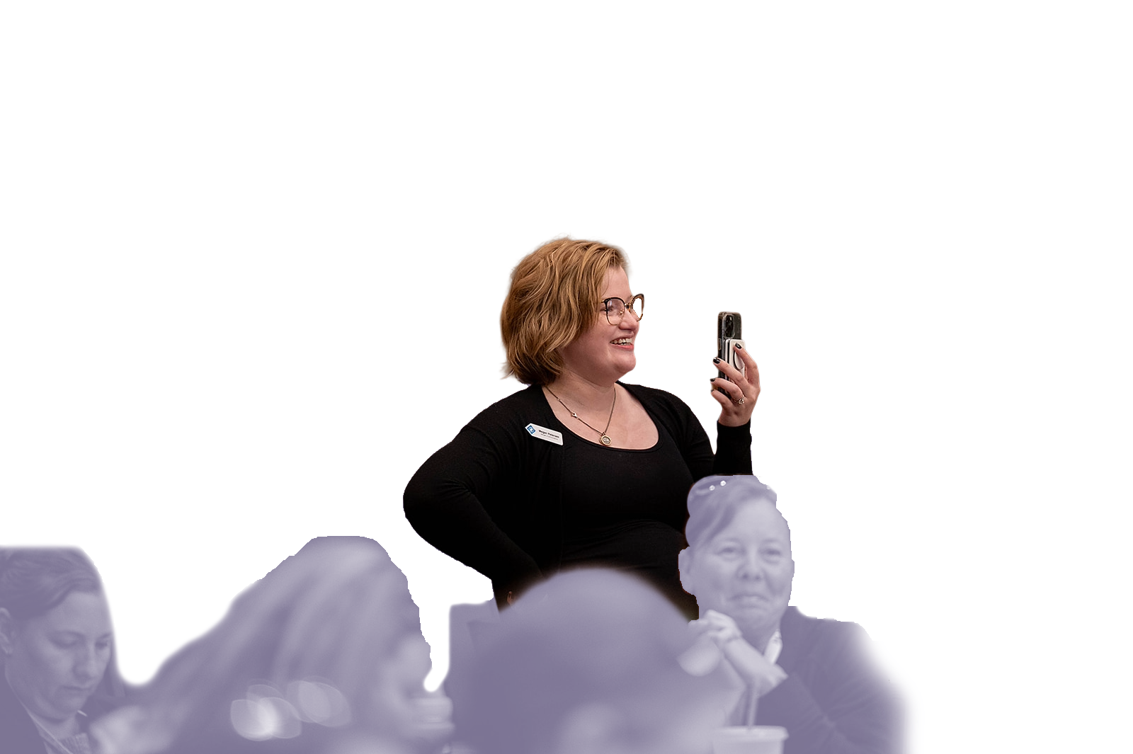
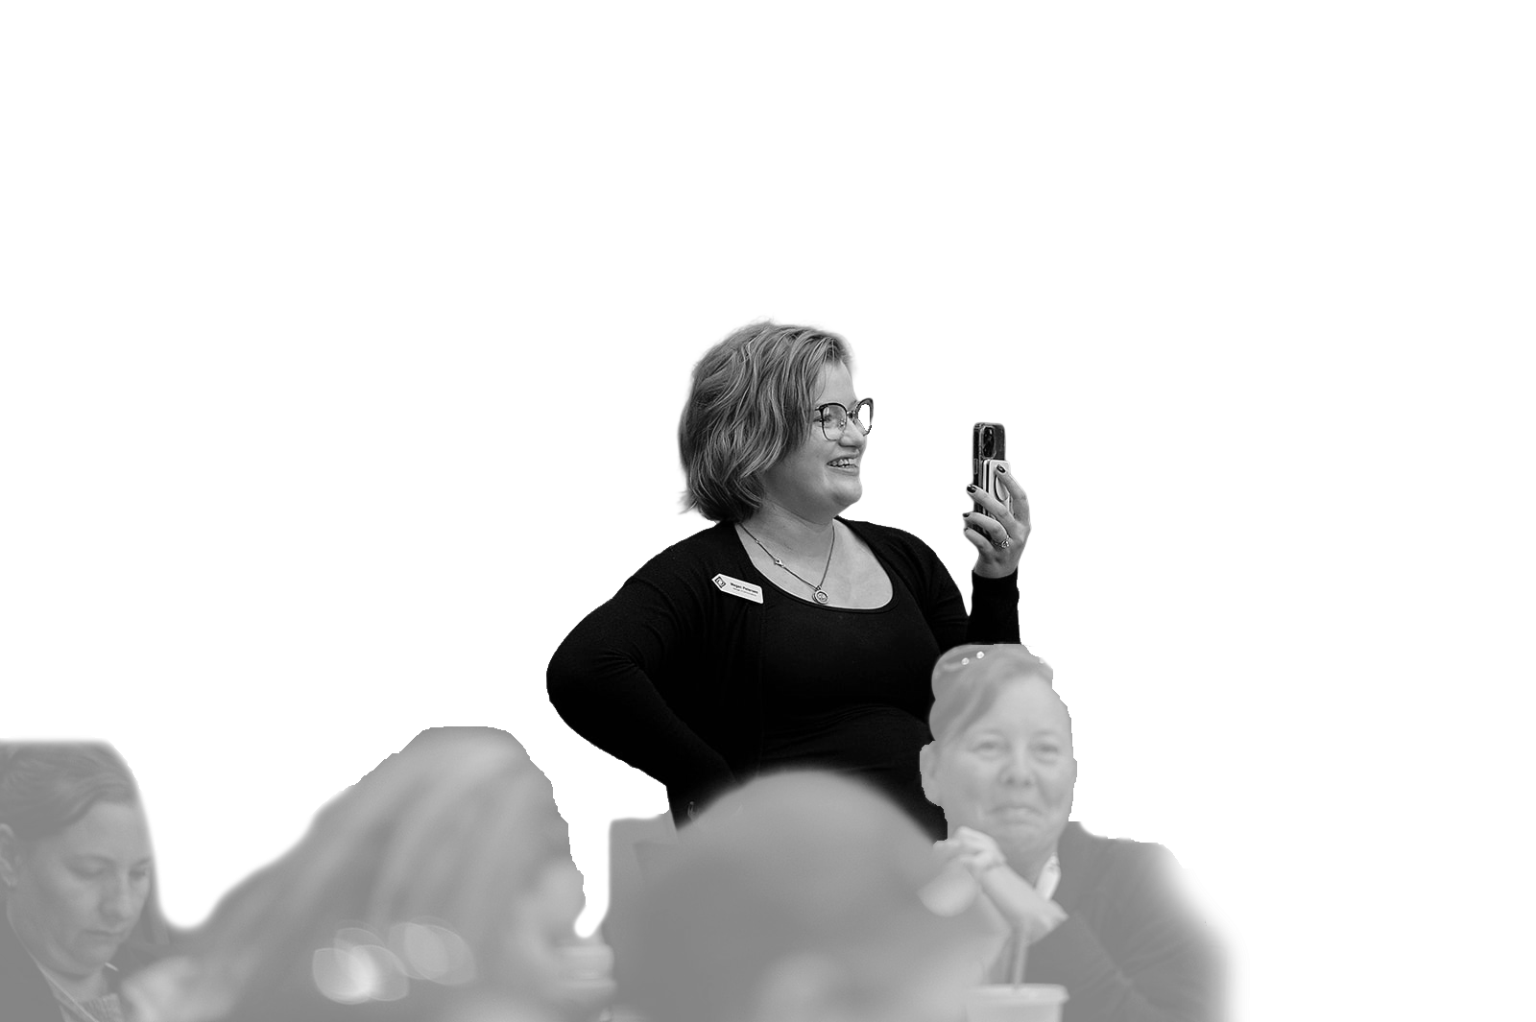
The reality of comms at a small non-profit
Notes:
How big is your team: more than 20, 10 or fewer, 5 or fewer, team of one
I am a comms department of one. I do branding, manage the website, create all graphic design and marketing collateral, am a point-of-contact for the press and media, on-staff writer, monitor/moderate our community page, hosted and produced our podcast, write and send out the newsletter, create one-pagers for advocacy, manage our social media…
We wear many hats, we are kind of expected to do everything. So at the dawn of the era of AI and LLMs, it can be tempting to cut out the “busy work” and reduce the time it takes to get things done.
If you’re using AI just to save your sanity in a tough moment, you’re not going to get judgement from me. But if we’re talking about best practices…
When we run on thin margins, we need to be cost-effective. Can you hire a dedicated person to do xyz? Going to talk specifically about member campaigns today as a sort of case-study for the cost-benefit analysis of using AI.

Slide 4
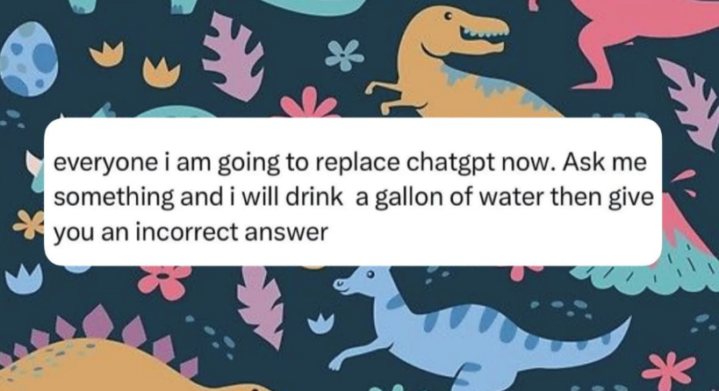
What do we mean when we say “AI”?
Large Language Models (LLMs): have a vast repository of content and use probability to guess what the next word in a sequence will be in order to answer questions.
  LLMs do not “think” or innovate
  LLMs mimic human writing and speech patterns
  LLMs hallucinate
A quick reminder: Computers are not magic.
Notes:
LLMs mimic: this is where hallucination can come from. It has no internal mechanism to fact-check itself, since it’s not drawing on an actual bank of knowledge the way human brains can. It’s putting words into a sequence based on patterns it analyzes from the information in its repository.
Computers are not magic: a friend of mine said this to me once over 15 years ago. I didn’t really get it at that time. But the expansion of LLMs has made that statement quite clear to me. Computers can’t think for themselves. They can only do what we ask them to do, what we instruct them to do. Computers can do incredible things, but they are limited by human limits in the sense that they can’t do anything we haven’t built out the infrastructure for, that we haven’t given instructions for, or that we haven’t already defined for them.

Slide 5
Quality, quantity, or a secret third thing

Slide 6
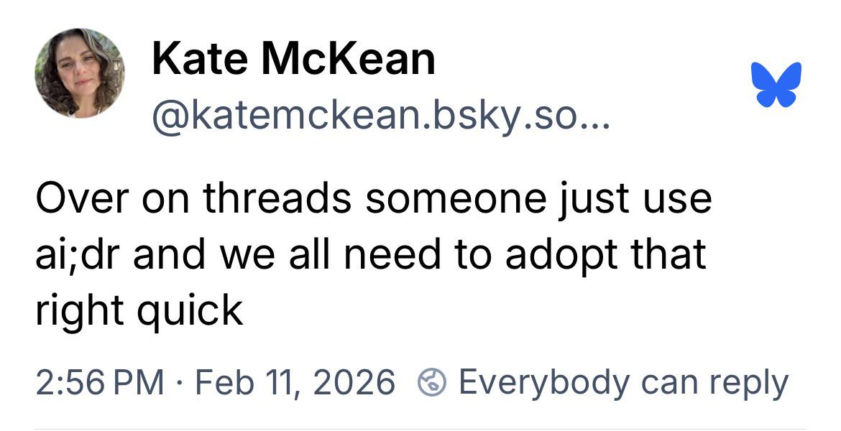
AI;DR
Some basic best practices:
  Brand style guide
  Using industry terms appropriately and accurately reflect your industry
  Distinguishing brand from competitors
  Use organization’s comms to connect with your community authentically.
Notes:
Brand style guide: font, colors, graphic specs. Brand voice, assumed education level (e.g. plain language vs not), level of professionality
Industry terms: people served vs. clients, person-first language (people with disabilities)
Appropriate use of diversity/DEI: We serve people with disabilities and do what we can to put their needs first and foremost, because we believe that’s what’s best for PWD is what’s best for providers. We also know that a large proportion of direct care staff in Minnesota are people of color, and women make up the vast majority of the disability services workforce. So when we talk about direct care workers in Minnesota, for example, we sort of know what demographics we’re talking about, and we try to be mindful of that.
Distinguishing brand: E.g. in Minnesota: 245D waiver vs. 144G, PWD vs assisted living, etc.
Authenticity: Not to speak badly about corporate comms and advertising, but you can kind of tell when you’re being marketed to. You can tell when it’s a massive conference room full of people crafting something vs. someone who truly understands you and what you need out of a particular product. (Why people respond so well to influencer marketing. You’re much more likely to believe a girl in her bedroom that a particular curling iron will change your life than some marketer in a suit.)

Slide 7
AI;DR
“
We find large differences in grammatical, lexical, and stylistic features, demonstrating that LLMs prefer specific grammatical structures and struggle to match the stylistic variation present in human communication, particularly as that variation aligns with the conventions that structure genres such as academic writing, interactive speech, or journalistic news.
“Do LLMs write like humans? Variation in grammatical and rhetorical styles. Reinhart et. al., 2025. pmc.ncbi.nlm.nih.gov/articles/PMC11874169/
”
Notes:
What this means: LLMs can’t do nuanced variation. They default to similar cadences, which are super obvious to those of us who notice such things. The “the apple pie is not just a dessert—it’s a symbol of American ingenuity.” So to get AI to not sound like AI…you’re going to have to feed it so much information to sound like something you could write. And maybe you don’t even have that. God knows you’ve been through six comms managers in the last ten years. So the amount of time to do anything of quality…there’s already a huge overhead. And like if you’re posting just to post, or sending an email just to send an email, is that the authentic communication that you’re looking for?

Slide 8
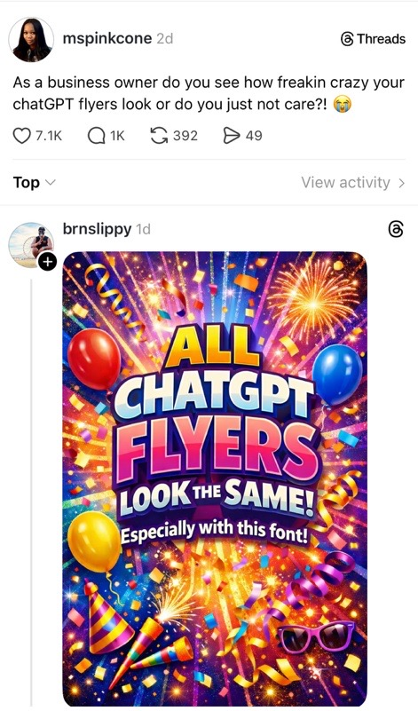
AI;DR
It all comes down to taste.
LLMs aim to please; be critical
Notes:
Taste: One area I will occasionally use AI for is drafting out of writer’s block. Sometimes it’s easier for me to take what I get and revise it heavily than sit there drowning in a blank page.
Meta-thinking: ask not only “did Chat fulfill my request” but “is this even a good idea” People sort of mistakenly think that because the LLM isn’t a person it’s somehow more objective than people. It isn’t. In some ways it’s doubly subjective…it’s subjective in the sense that it’s built on the assumptions of its programmers and the repository of resources it’s trained on, and it’s subjective because it’s going to take you at face-value and do whatever you ask uncritically.
(Taste is the secret third thing)

Slide 9
Member Renewal Campaigns
Notes:
About our member renewals: all our members renew at once. Our members are all businesses: either organizational members, aka providers. Or associate members, aka vendors, orgs that provide services to providers. (We’ve got a couple insurance companies, pharmacies, tech/SaaS for providers, that sort of thing). So everyone renews at the end of the calendar year. This campaign only went out to organizational members (e.g. providers) and was sent only to the primary contacts at those organizations. We do not have this set up as an ongoing HL campaign at this point; last year was my first year at ARRM and while I’m considering it, I did like the ability to tweak as I went and comment on events as they occurred, because we had a lot going on in Minnesota last fall.
We tend to fall between a 90-98% retention rate year-to-year. We had 93% of our members renew last year. In case it’s relevant: open rates in Informz were between 40% and 66%. Clicks were between 29% and 74%.

Slide 10
ChatGPT
Subject: Continue Strengthening Minnesota’s Disability & Mental Health Community
Dear [Member Name],
As a valued ARRM member, you play a vital role in strengthening services for people with disabilities and mental health needs across Minnesota. Your partnership ensures that organizations like ours can advocate fiercely, share essential information, and support providers doing life-changing work every day.
Your membership renewal helps sustain this mission.
Please take a moment to renew today so we can continue standing with you in the year ahead.
Renew here: [Renewal Link]
Thank you for your leadership and commitment to the people we serve.
Warmly,
[Your Name]
ARRM
Notes:
New Chat—free version. I gave Chat our mission statement and asked it to write a series of emails. No other info about ARRM.

Slide 11
Megan
Subject: Renew Today – Keep your ARRM Membership in 2026!
Dear [Member Name],
The last few weeks, we've been sharing with you the value of ARRM and encouraging members to start the member renewal process now as we gear up for 2026. And last week at Leadership Conference, we heard all the ways that ARRM members have put that value into action: serving on our committees to push disability services forward, advocating in Congress and the State Legislature to advance our policy agendas, and connecting with other members to make our industry better.
This is a friendly reminder that ARRM membership renewals are due by Friday, October 17. Renewing today secures your organization’s continued access to advocacy, resources, and community connections in 2026.
Click here to begin the member renewal process so you'll have access to all your member benefits in 2026.
Please don't hesitate to reach out to me with any questions.
Sincerely,
Hope Hilgenberg, Manager of Member Experience
Notes:
46% open, 26% click-through.

Slide 12
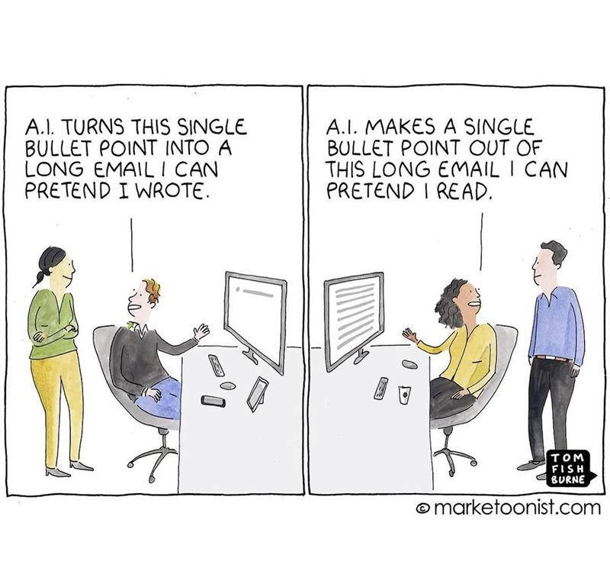
Comparison
Chat GPT email
  Briefer
  More generic
  Not in our brand voice
My email
  Longer
  Timely
  Less generic writing style
Notes:
Brevity: not my strength
Brand voice: We don’t really talk about ourselves this way—I didn’t tell Chat that, so it wouldn’t know.
Chat also doesn’t know that we had a conference the week before and what we heard at that conference. I could have put together a prompt asking it to do all those things and consider all of this, or started with that version and edited from there. But that likely would have taken more time than simply doing it myself. I’ve heard AI described as an over-eager intern. You kind of have to hold its hand to get it to do what you need it to do. And if I had an intern who I was trying to help become a comms leader one day, I would feel very differently about taking that time. I don’t feel that obligation to an LLM.
I could also see the counterargument that…well, you can’t really compare Chat to your writing because you didn’t tell it xyz. But I think having that expertise in the room is important—Chat isn’t going to prompt you to provide it with more information, or say “if you give me xyz I can craft abc.” It doesn’t innovate or bring out new ideas. It just regurgitates based on probability.
We can outsource connection, or we can strengthen it.

Slide 13
Chat example 2
Subject: “Weeks like this are why we have ARRM.”
Dear [Member Name],
In the midst of recent headlines and rising scrutiny on disability services, one member summed up the moment perfectly: “Weeks like this are why we have ARRM.”
When accusations of widespread fraud swept across Minnesota, ARRM moved quickly—providing accurate information, meeting with state leaders, and ensuring policymakers understood the real story of the work you do every day. We also created space for members to ask questions, share concerns, and get clear guidance in a rapidly shifting environment.
This is the role ARRM plays—steady, coordinated, and focused on protecting the people and organizations that make quality services possible. And your membership is what allows us to do it.
As we prepare for a pivotal year of policy, regulation, and system reform, we hope you’ll continue to stand with us. Renew your membership today, and remain part of a strong, unified voice advocating for disability services statewide.
Renew your membership →
Notes:
In this example: Write me a series of six emails encouraging our members to renew their membership. Base it around a statement made by a member: "Weeks like this are why we have ARRM." This statement was made in the wake of accusations of widespread fraud in disability services in Minnesota. Write it in our brand voice.

Slide 14
Megan
Subject: “Weeks like this are why we have ARRM.”
Dear ,
"Weeks like this are why we have ARRM."
That's what we heard from one member last week in the wake of Governor Walz's announcement about a third-party audit on billing under 14 waiver service lines.
ARRM rallied our response within minutes of learning about the announcement: we got together with providers to get our voices in the media across the state, and we are pressing our contacts at DHS for a meeting as soon as possible so we can get some clarity for our members. We also reached out to our contacts at the legislature to coordinate efforts, and we are preparing for the difficult conversations around fraud that are likely to arise during the 2026 Legislative Session.
We know this is a challenging time for providers. ARRM can be part of the solution, but we are only as strong as our members. When you commit to renewing for 2026, you help ensure that we can rise to any challenge the new year brings. We won't charge you for your 2026 membership today, but having your commitment now helps us plan for the future.
Let us know if you have any questions or encounter any issues with the form.
Sincerely,
Rachel Dyer
Director of Finance, ARRM
Notes:
One thing that’s included here is connecting that it’s possibly the most challenging thing providers in MN have ever encountered and we’re asking them for money. Holding those two truths—like we need your participation to fight for our industry.
A big point in both of these: looking specifically at what are we doing for members? Connecting the dots for them about what we do for them. Members don’t always know what their association does. Like you have those people who are going to be members of their professional association regardless, but other people need to be reminded. Their bottom lines are also shrinking, and they need to understand the value that you deliver. And you don’t do that in one email. You do that consistently over the course of the year, and then use the renewal campaigns to remind them why.
Open 60%, click 47%

Slide 15
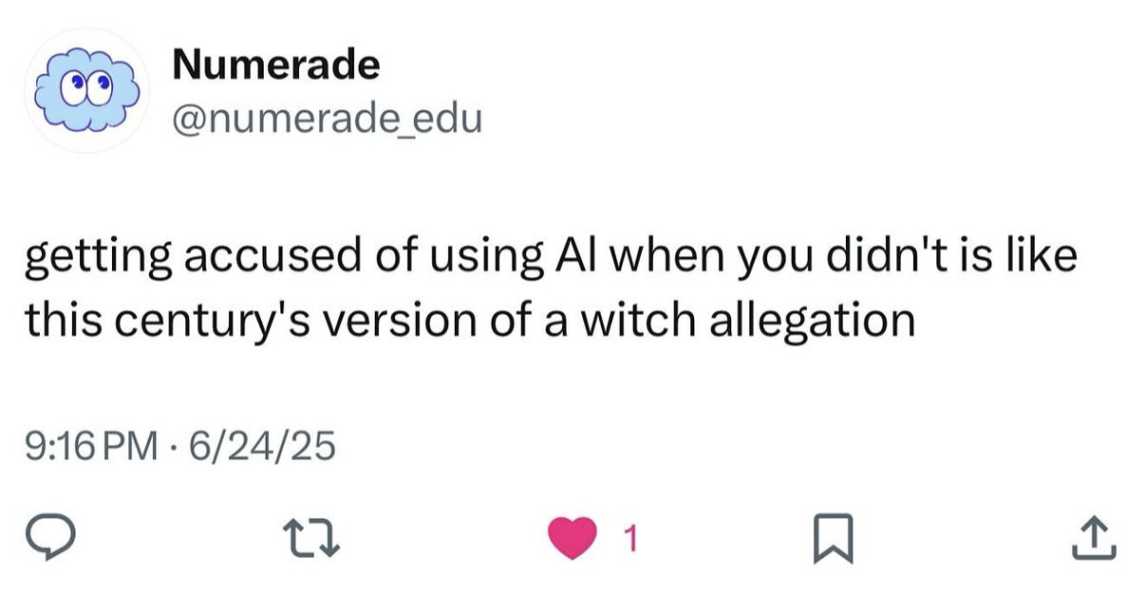
Comparison
ChatGPT email
  Briefer
  Not as detailed about what happened with the fraud allegations/the governor’s announcement
My email
  Longer/less brief
  More detailed

Slide 16
Some final thoughts
Notes:
You can kind of think of…quick, good, and cheap, pick two. If you want quick and cheap, but maybe not good, Chat GPT will get you content to dump into a newsletter template. Done. But if you want good to be anywhere in that equation—and if good for you means authentic, with a human touch, you either need to heavily edit what Chat GPT gets you, or just write it yourself. Now what that means for you and your organization is ultimately up to you. But I’m begging you to please keep your critical thinking at the forefront, because Chat GPT is never going to say, “no, it’s going to sound bad if I write that for you.” It’s not going to ask follow-up questions to see what you mean, or how you think, or what the brand standards are. It’s just going to spit it out. So—and this is for the CEOs and execs in the room who are staring at their budget and wondering where to invest—please invest in your comms teams. One thing that ARRM has been great at is being supportive when I say, “Nope, that’s not my area of expertise and I really think we need to contract it out.” I can do a lot by way of comms, but I am not a photographer. So we bring in a professional event photographer to document our events and I can be doing our socials, be available for other things as-needed, etc., and we get incredible photos that were not taken on an iPhone that I can then use in our collateral for the next year. Know the limits of your team—Chat GPT is not a replacement for someone who knows a craft. It’s a quick and dirty fix that can help in a pinch, but when it comes to writing and graphics, it’s just not gonna measure up.

Slide 17
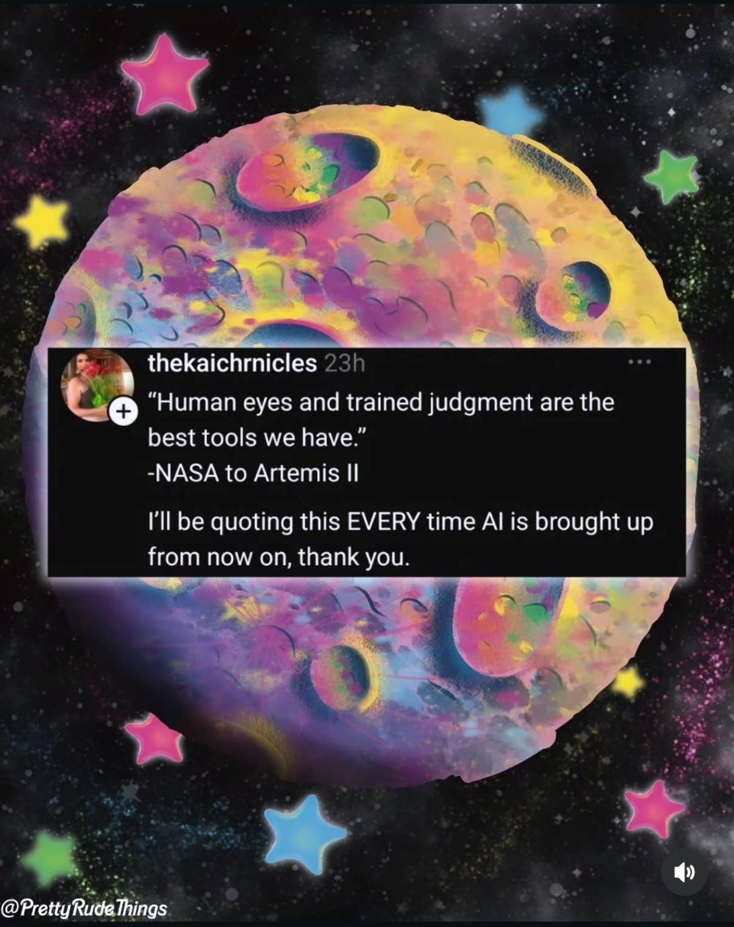
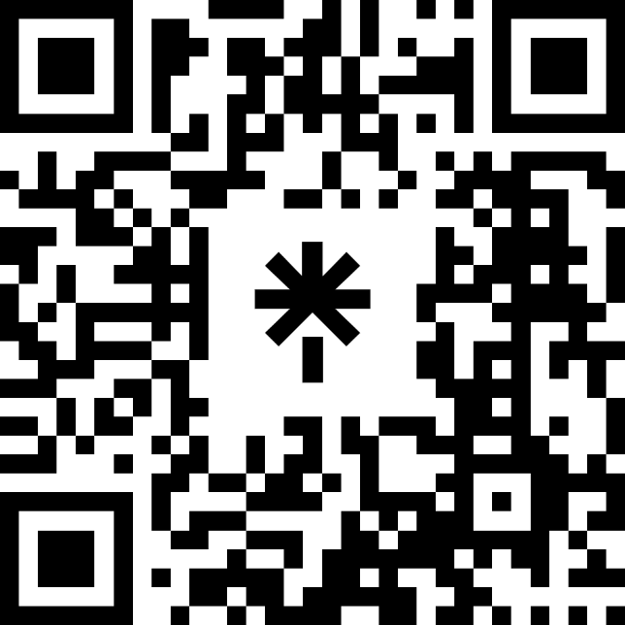
Questions?
Get in touch with me!
Email: mpetersen@arrm.org
LinkedIn:
Don’t forget to take the Super Forum survey in the mobile app!

Slide 18
thank you!

